Slide 1
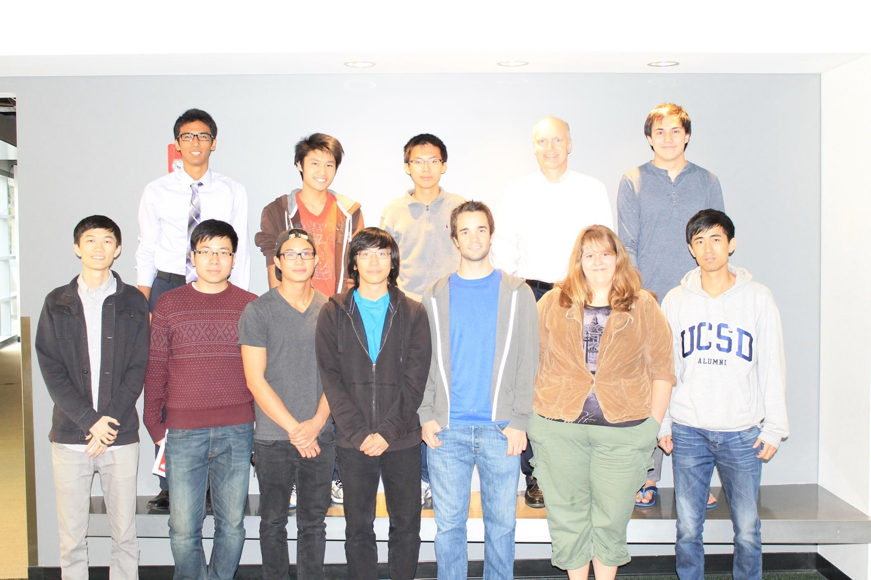
DVS
Fall
2013
Shannon Harris. Arvind Rao, Steven Yuan, Shumin Gao, David Chan, Brian Nguyen, John Chan, Jonevan Brown, Tianyu(Mark) Ma, Andrew Fong, Andrew Nguyen, Andreas H Djokic
Notes:
Andrew Fong

Slide 2

Client Overview
Shiley Eye Center
Only academic institution with programs for eye disorder research, treatment, and education.
Save Our Children’s Sight program
Helping to identify, treat, and ultimately prevent common eye disorders in children early on to give them the vision they need to succeed in school and life
Notes:
David

Slide 3
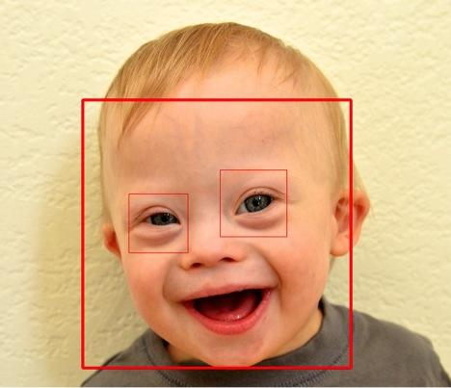

Project Overview
Design a Digital Vision Screening system that can help professionals identify potential eye problems in children with special needs.
Notes:
Arvind

Slide 4
Subteams Overview
Hardware
Camera and flash to take red eye photos
Front End
Create GUI
Integrate with Backend
Back End
Feature Extraction
uses image analysis to detect certain features of the eye
Disease Detection
analyzes features to detect strabismus, astigmatism, and cataracts
Notes:
Steven

Slide 5
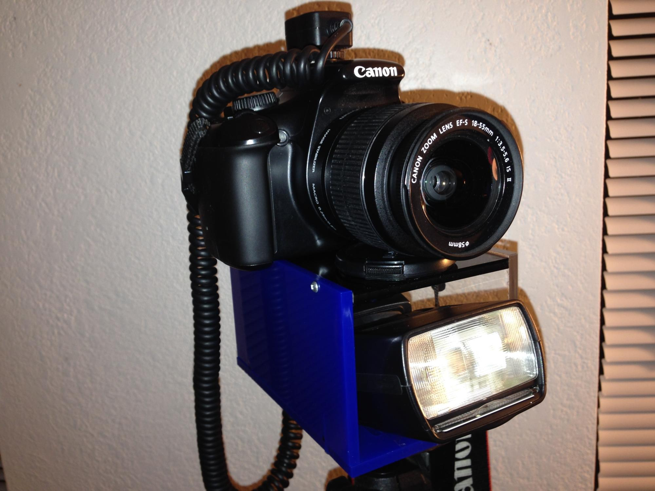
Hardware
Camera
Canon EOS Rebel T3
Used to capture pupil and crescent.
Yongnuo Speedlite Flash
Used to create red eye.
Uses Eye-fi to transfer pictures instantly to computer after capture.
Bracket
Acrylic Prism
holds the flash at a distance close to the camera lense.
Used to mount camera to flash and tripod
Notes:
Brian

Slide 6
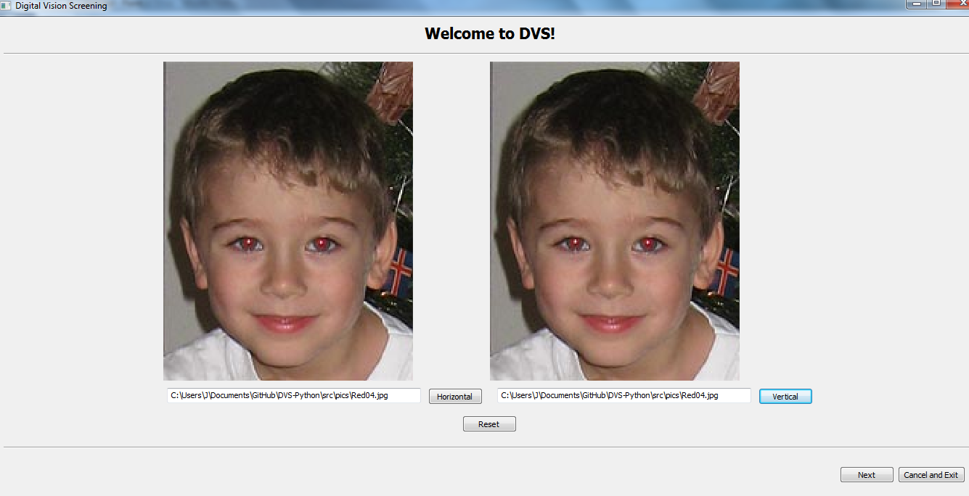
Front End
Quarter Accomplishments
-Revised flow of UI
Quarter Goals
-Clean up the code
-Implement user input
-Pages to work with backend
Notes:
John

Slide 7
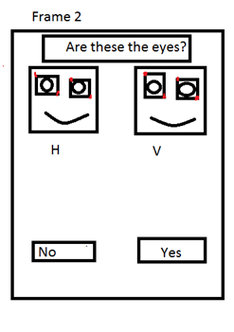
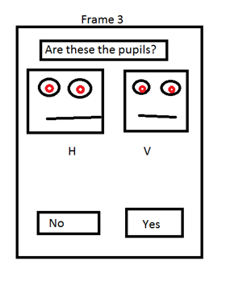
Front End - Future Frames
Yes -> Frame 3
No -> Frame 4

Slide 8
Back End - General Info
Task: Image processing & analysis
(based on red eye photo)
Team Size: 3 ~ 5 (out of 11)
Language: Python
Environment: Windows, Mac, Linux
Notes:
Mark

Slide 9
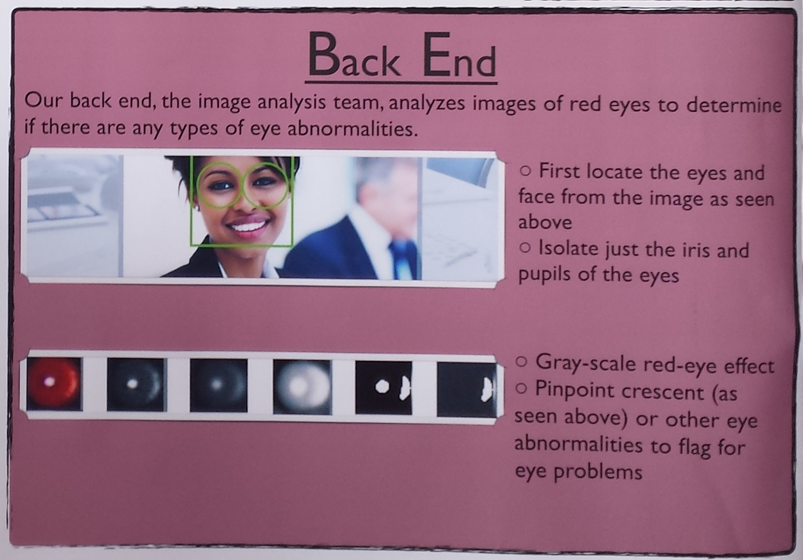
Back End - Brief Rundown
Thresholding
Identification
(Processing)
- eyeball
- pupil
- crescent
Calculation
(Analysis)
crescent
pupile
%
Notes:
Mark

Slide 10
Future Goals
This Quarter
Get a roughly working GUI
Finish rough feature detection for all parts of the eye
Figure out and document the status of the hardware
And Beyond
Fully integrate front end and back end
Fully implement disease detection algorithms
Use machine learning to differentiate between healthy and diseased eyes
Develop, debug, and optimize
Test the program with the client
Notes:
Shannon

Slide 11

Questions and Answers
Notes:
Shannon

